Slide 1


Secure Sense
Pattern Recognition and Anomaly Detection in Employee Activities for Enhanced Security
Team Members
Muni Eshwar Evakattu
Pallavi Suma Kurmala

Slide 2
Introduction
Secure Sense is a system that combines a monitoring and analysis of employee behavior to alert of atypical behavior, or no sign based on the usage of machine learning algorithms. Through using data on employee's login/logout activities along with URL logins, this program looks to strengthen the security measures and productivity upgrades in the workplace.
The important preventive system of Secure Sense is based on ongoing monitoring of employee behavior. This method provides early detection of the suspicious activities and threats which in turn helps the organizations to strengthen their defenses and get more preparation by gaining the knowledge beforehand.
Applying the strengths of machine learning algorithms, Secure Sense gives an advanced yet simple tool which is used to upgrade the data protection protocols as well as the data information protection.

Slide 3
Problem Definition
What problems are we trying to address?
01
02
03
04
By introducing proactive monitoring and automated detection, Secure Sense aims to swiftly identify and respond to suspicious activities in real-time.
How can we improve upon traditional security measures, which are mainly reactive?
This approach enhances cybersecurity resilience and mitigates potential risks effectively.
Secure Sense's threat detection capabilities address the challenge of instability in security measures, offering immediate responses to suspicious incidents.

Slide 4

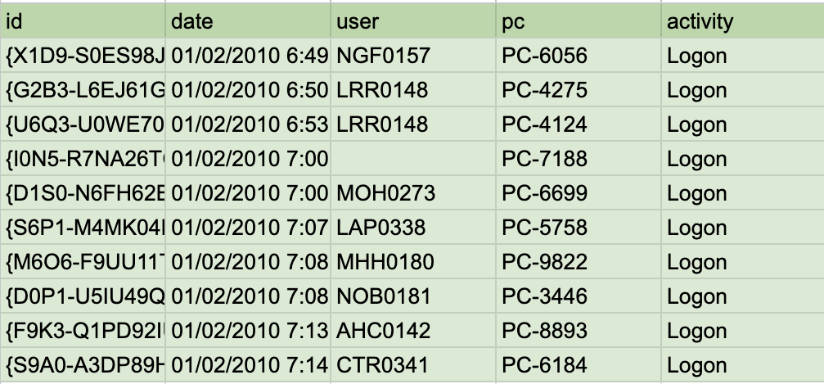
DataSets
Logon.csv
Fields: id, date, user, pc, activity(Logon/Logoff)

Slide 5

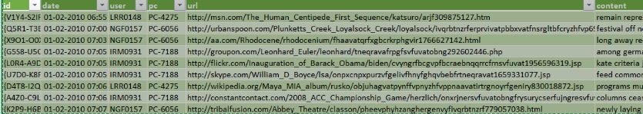
DataSets
http.csv
Fields: id, date, user, pc, url, content

Slide 6
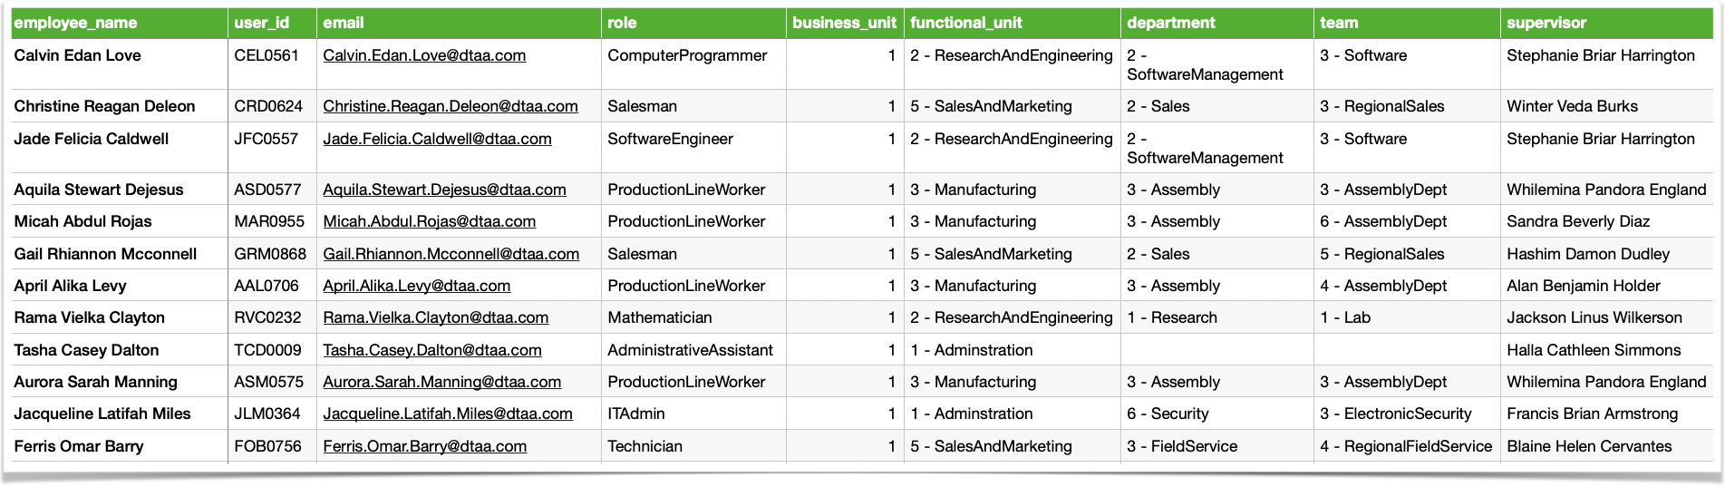
DataSets
EmployeeDetails.csv
Fields: employee_name , user_id, email, role,business_unit, department ,team, supervisor

Slide 7
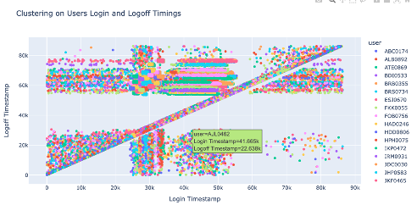
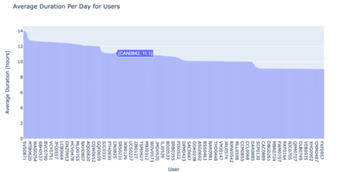
Data Analysis
For Logon.csv dataset upon inspection, missing values were identified in the activity column, with some entries missing logon times and others missing logoff times.
For entries with both logon and logoff times available, the number of productive hours per user was calculated.
To address the missing values, collaborative filtering was considered. This involves predicting the logoff/logon time based on similar user logoff/logon patterns.

Slide 8
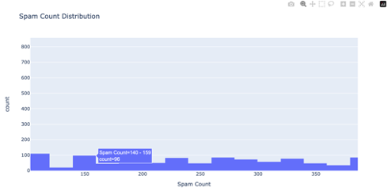
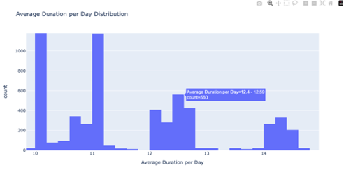
Data Analysis
Employed_Combined_Dataset.csv
The dataset comprises employee details including name, email, role, supervisor, business unit, etc.
To streamline processing, all 12 employee detail files were concatenated into one consolidated file.
Additionally, outcomes from device info and HTTP info files were incorporated.
These three tables were mapped by user to provide a comprehensive understanding of user behavior and interactions.

Slide 9
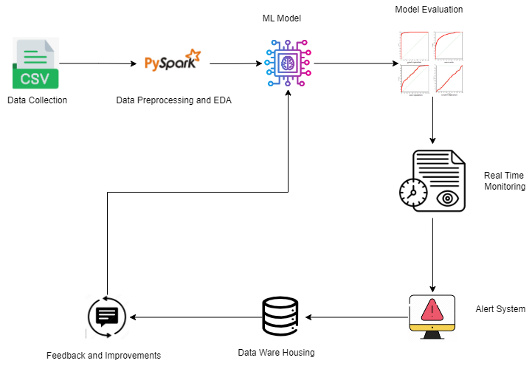
Flow Chart

Slide 10
Methodology
URL Clustering
Tokenize URLs, extract TF-IDF features, and apply K-means clustering to group URLs into spam/ham categories.
Finding the association of spam with con textual data of employee’s
We first preprocessed the data by encoding categorical variables and splitting it into training and testing sets. Then, we trained and evaluated five machine learning models - Linear Regression, Decision Tree, Random Forest, SVR, and XGBoost - using Mean Squared Error as the performance metric. Among these, Decision Tree and Random Forest showed the lowest MSE, indicating their potential for accurate prediction of spam count or average duration per day based on user attributes.

Slide 11
Preliminary Results
Initial analysis concentrated on user behaviour and security threat detection.
'logon.csv' data was processed to calculate daily work hours for each user.
Unsupervised learning via K-means clustering was applied to 'http.csv' to categorise URLs as spam or ham.
A comprehensive table was created, incorporating employee details, average daily work hours, and frequency of attempts to access spam URLs.
These insights serve as the basis for ongoing investigations, offering valuable understanding of user activity and potential security risks.

Slide 12
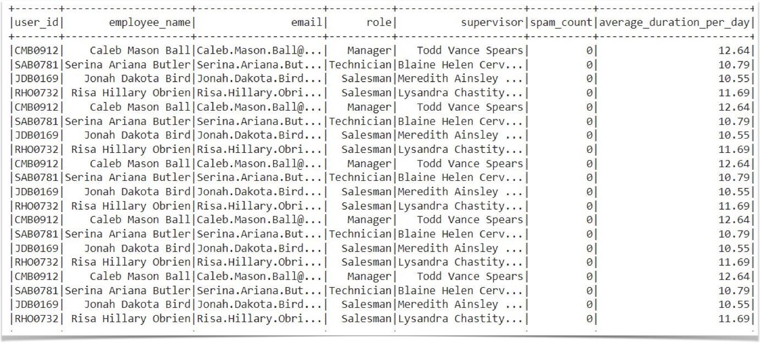
Results

Slide 13
Related Work
An Investigation of Employees' Intention to Comply with Information Security System—A Mixed Approach Based on Regression.
https://www.ncbi.nlm.nih.gov/pmc/articles/PMC9737675/
Evaluating Staff Attitudes, Intentions, and Behaviors Related to Cyber Security in Healthcarehttps://www.ncbi.nlm.nih.gov/pmc/articles/PMC10585427/
Understanding Employee Security Behavior in Using Information System of Organizations: Evidence from Jakarta Greater Area, Indonesia
http://www.jatit.org/volumes/Vol100No12/5Vol100No12.pdf

Slide 14
Future Plans
Experiment with different features and clustering algorithms for URL analysis (e.g., URL length, domain-specific words, hierarchical clustering, Gaussian Mixture Models).
Develop more advanced anomaly detection algorithms to handle complex patterns and adapt to evolving threats.
Incorporate real-time monitoring and analysis capabilities as a simulation.
Explore the integration of contextual information (user role, device type, time of day) for improved accuracy. Investigate deep learning architectures (RNNs, transformers) for anomaly detection.
Evaluate the system's effectiveness across different industries and domains.

Slide 15
Team Roles and Responsibilities
Evakattu Muni Eshwar: Worked on spam/ham URL classification using unsupervised learning, data handling, preprocessing, feature engineering, and modeling.
Pallavi Suma Kurmala: Analysed user working duration per day using logon_info and employee details datasets, data handling, preprocessing, feature engineering, and modeling.

Slide 16
Thank You.
😀

